Slide 1
Naïve Bayes & SVM
Classification | Gaussian | Bernoulli | Kernel

Slide 2
Bayes’ Theorem
How does computers learn about humans?
An internet search for "movie automatic shoe laces" brings up "Back to the future“.
Has the search engine watched the movie?
No, but it knows from lots of other searches what people are probably looking for.
And it calculates that probability using Bayes' Theorem.

Slide 3
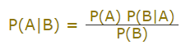
Bayes’ Theorem
Bayes' Theorem is a way of finding a probability when we know certain other probabilities.
The formula is:
Which tells us: how often A happens given than B happens, P(A|B)
When we know: how often B happens given that A happens, P(B|A)
and how likely A is to happen independently, P(A)
and how likely B is to happen independently, P(B)

Slide 4
Example
Shall we go for a picnic?
You are planning a picnic today, but the morning is cloudy
Oh no! 50% of all rainy days start off cloudy!
But cloudy mornings are common (about 40% of days start cloudy)
And this is usually a dry month (only 3 of 30 days tend to be rainy, or 10%)
What is the chance of rain during the day?

Slide 5
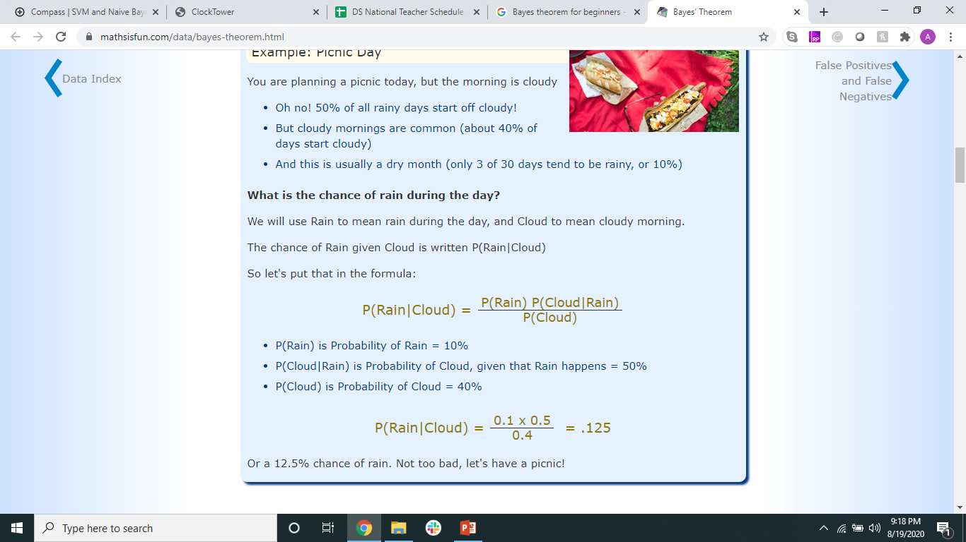
Example
We will use Rain to mean rain during the day, and Cloud to mean cloudy morning.
The chance of Rain given Cloud is written P(Rain|Cloud)
So let's put that in the formula:

Slide 6
Example
P(Rain) is Probability of Rain = 10%
P(Cloud|Rain) is Probability of Cloud, given that Rain happens = 50%
P(Cloud) is Probability of Cloud = 40%
Or a 12.5% chance of rain. Not too bad, let's have a picnic!

Slide 7
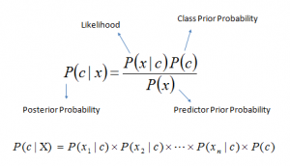
Summary
Bayes theorem provides a way of calculating posterior probability P(c|x) from P(c), P(x) and P(x|c).
P(c|x) is the posterior probability of class (c, target) given predictor (x, attributes).
P(c) is the prior probability of class.
P(x|c) is the likelihood which is the probability of predictor given class.
P(x) is the prior probability of predictor.

Slide 8
Naïve Bayes
Robust classifier
Not affected by irrelevant features
Assumption – Independent Variables are not correlated, hence the name
Doesn’t care about distribution (except Gaussian NB), skewness, bias in data

Slide 9
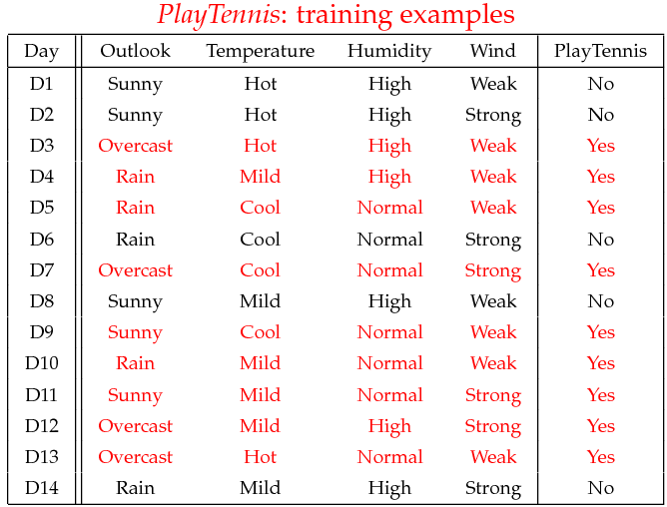
Example

Slide 10
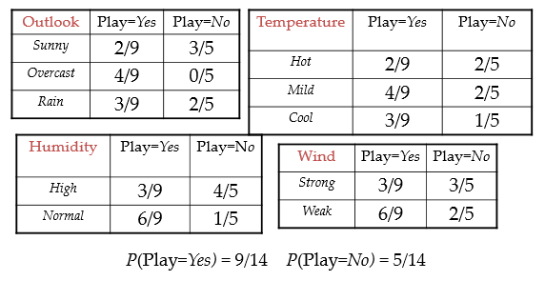
Learning Phase

Slide 11
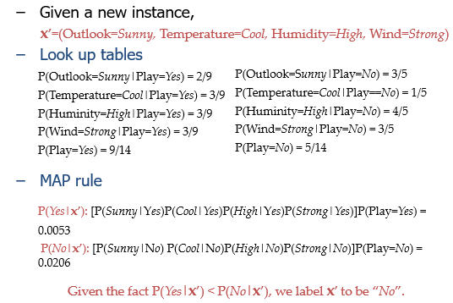
Testing Phase

Slide 12
MAP Rule
MAP = Maximum A Posteriori
Maximum a Posteriori or MAP for short is a Bayesian-based approach to estimating a distribution and model parameters that best explain an observed dataset.
Maximum a Posteriori estimation is a probabilistic framework for solving the problem of density estimation.
MAP involves calculating a conditional probability of observing the data given a model weighted by a prior probability or belief about the model.
MAP provides an alternate probability framework to maximum likelihood estimation for machine learning.

Slide 13
The Zero Frequency Problem
If categorical variable has a category (in test data set), which was not observed in training data set, then model will assign a 0 (zero) probability and will be unable to make a prediction. This is often known as Zero Frequency.
To solve this, we can use the smoothing technique. One of the simplest smoothing techniques is called Laplace estimation.

Slide 14
Types of NB
Gaussian: It is used in classification and it assumes that features follow a normal distribution.
Multinomial: It is used for discrete counts. For example, let’s say, we have a text classification problem. Here we can consider Bernoulli trials which is one step further and instead of “word occurring in the document”, we have “count how often word occurs in the document”, you can think of it as “number of times outcome number x_i is observed over the n trials”.
Bernoulli: The binomial model is useful if your feature vectors are binary (i.e. zeros and ones). One application would be text classification with ‘bag of words’ model where the 1s & 0s are “word occurs in the document” and “word does not occur in the document” respectively.

Slide 15
Advantages
Naïve Bayes based on the independence assumption
Training is very easy and fast; just requiring considering each attribute in each class separately
Test is straightforward; just looking up tables or calculating conditional probabilities with normal distributions
Works well with less data!
A popular generative model
Performance competitive to most of state-of-the-art classifiers even in presence of violating independence assumption
Many successful applications, e.g., spam mail filtering
A good candidate of a base learner in ensemble learning

Slide 16
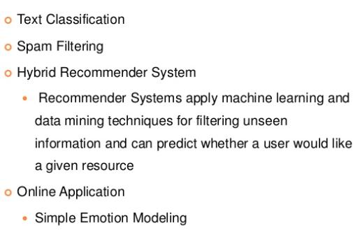
Applications

Slide 17

Text Classification

Slide 18

Examples of Text Classification

Slide 19

Naïve Bayes Approach

Slide 20
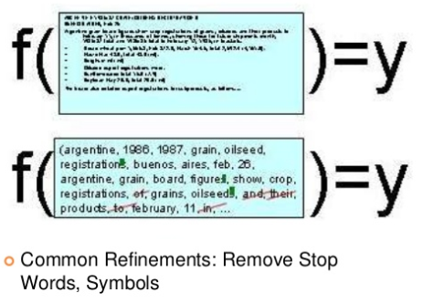
Representing Text: List of Words

Slide 21
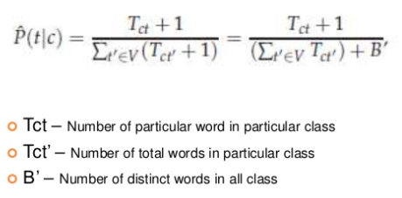
Text Classification

Slide 22
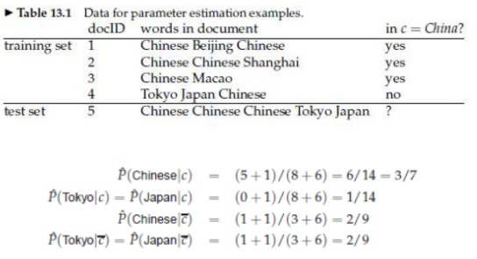
Example

Slide 23

Example

Slide 24
Naïve Bayes Results
F1 score should be as close to 1 as possible
Kappa Value (cohen_kappa_score) should be at least 0.9
Precision and Recall
Accuracy via confusion matrix

Slide 25
Tips to improve NB model
If continuous features do not have normal distribution, we should use transformation or different methods to convert it in normal distribution.
If test data set has zero frequency issue, apply smoothing techniques “Laplace Smoothing” to predict the class of test data set.
Remove correlated features, as the highly correlated features are voted twice in the model and it can lead to over inflating importance.
Naive Bayes classifiers has limited options for parameter tuning like alpha=1 for smoothing, fit_prior=[True|False] to learn class prior probabilities or not and some other options. Focus on your pre-processing of data and the feature selection.
You might think to apply some classifier combination technique like ensembling, bagging and boosting but these methods would not help. Actually, “ensembling, boosting, bagging” won’t help since their purpose is to reduce variance. Naive Bayes has no variance to minimize.

Slide 26
Hands on
https://github.com/2796gaurav/Naive-bayes-explained/tree/master/Naive%20bayes
https://www.datacamp.com/community/tutorials/naive-bayes-scikit-learn
https://chrisalbon.com/machine_learning/naive_bayes/multinomial_naive_bayes_classifier/
https://towardsdatascience.com/comparing-a-variety-of-naive-bayes-classification-algorithms-fc5fa298379e

Slide 27
Good to know…
Market Basket Analysis – Association Rule Mining
Simple but very useful algorithm – Apriori.
Key Concepts:
Confidence - It signifies the likelihood of item Y being purchased when item X is purchased.
Lift - This signifies the likelihood of the item Y being purchased when item X is purchased while taking into account the popularity of Y.
https://medium.com/@notesharsha/market-basket-analysis-sneaky-psychology-of-supermarkets-simple-guide-using-python-eacfd33cc882
https://intellipaat.com/blog/data-science-apriori-algorithm/
https://pbpython.com/market-basket-analysis.html

Slide 28
Support Vector Machines
Say your dataset looks like this –

Slide 29
Support Vector Machines
How can we separate this?

Slide 30
Support Vector Machines
How about this?

Slide 31
Support Vector Machines
Or this?

Slide 32
Support Vector Machines
Infinite ways!

Slide 33
Support Vector Machines
Which is the best way?

Slide 34
Support Vector Machines
How would you classify this data point?
Misclassified
to +1 class

Slide 35
Support Vector Machines
Define the margin of a linear classifier as the width that the boundary could be increased by before hitting a data point.

Slide 36
Support Vector Machines
Maximum Margin
Maximizing the margin is good
Implies that only support vectors are important; other training examples are ignorable.
Support Vectors are those datapoints that the margin pushes up against
The maximum margin linear classifier is the linear classifier with the, um, maximum margin.
This is the simplest kind of SVM (called an LSVM)

Slide 37
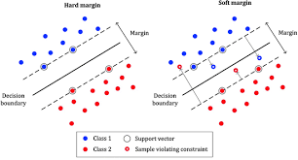
Hard Margin Vs. Soft Margin

Slide 38
Hard Margin Vs. Soft Margin
Hard margin SVM can work only when data is completely linearly separable without any errors (noise or outliers).
In case of errors either the margin is smaller or hard margin SVM fails.
On the other hand soft margin SVM solves this problem by introducing slack variables.

Slide 39
Kernels
Feature Projections to higher dimension
What??
Say your data is like this –
How can you classify?

Slide 40
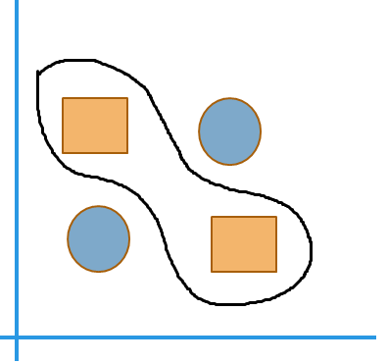
Kernels

Slide 41
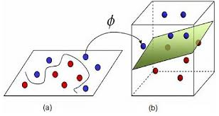
Kernels

Slide 42

Kernels

Slide 43

SVM – Another try

Slide 44

SVM – Another try

Slide 45

SVM – Another try

Slide 46

SVM – Another try

Slide 47

SVM – Another try

Slide 48

SVM – Another try

Slide 49

SVM – Another try

Slide 50

SVM – Another try

Slide 51

SVM – Another try

Slide 52

SVM – Another try

Slide 53

SVM – Another try

Slide 54

SVM – Another try

Slide 55

SVM – Another try

Slide 56

SVM – Another try

Slide 57

SVM – Another try

Slide 58

SVM – Another try

Slide 59

SVM – Another try

Slide 60

SVM – Another try

Slide 61

SVM – Another try

Slide 62

SVM – Another try

Slide 63

SVM – Another try

Slide 64

SVM – Another try

Slide 65

SVM – Another try

Slide 66

SVM – Another try

Slide 67

SVM – Another try

Slide 68

SVM – Another try

Slide 69

SVM – Another try

Slide 70

SVM – Another try

Slide 71
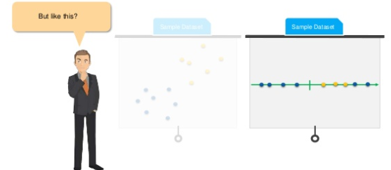
SVM – Another try

Slide 72

SVM – Another try

Slide 73

SVM – Another try

Slide 74

SVM – Another try

Slide 75

SVM – Another try

Slide 76

SVM – Another try

Slide 77
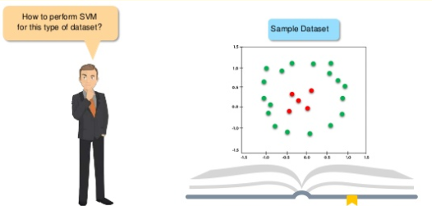
SVM – Another try

Slide 78
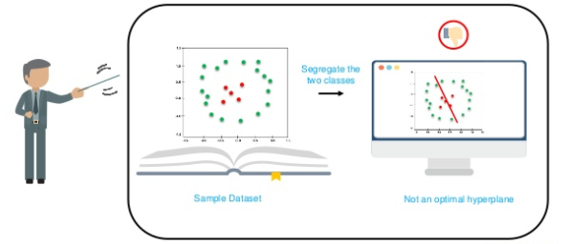
SVM – Another try

Slide 79
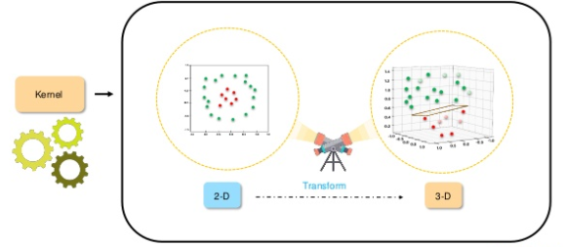
SVM – Another try

Slide 80

SVM – Another try

Slide 81

SVM – Another try

Slide 82

SVM – Another try

Slide 83

SVM – Another try

Slide 84

SVM – Another try

Slide 85
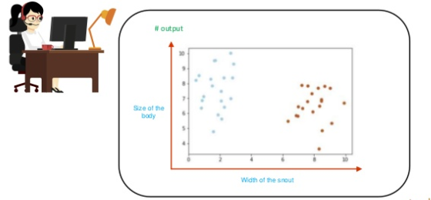
SVM – Another try

Slide 86

SVM – Another try

Slide 87
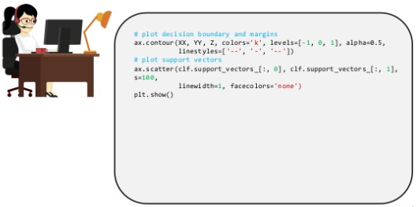
SVM – Another try

Slide 88
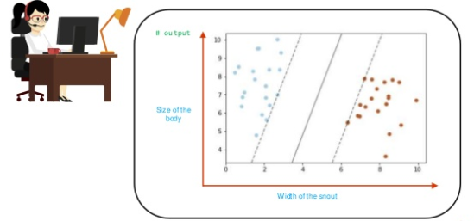
SVM – Another try

Slide 89

SVM – Another try

Slide 90




A Cautionary Example
Image classification of tanks. Autofire when an enemy tank is spotted.
Input data: Photos of own and enemy tanks.
Worked really good with the training set used.
In reality it failed completely.
Reason: All enemy tank photos taken in the morning. All own tanks in dawn.
The classifier couldn’t recognize dusk from dawn!!!!

Slide 91
Tips to tune SVM
Kernel: The main function of the kernel is to transform the given dataset input data into the required form. There are various types of functions such as linear, polynomial, and radial basis function (RBF). Polynomial and RBF are useful for non-linear hyperplane.
Regularization: Regularization parameter in python's Scikit-learn C parameter used to maintain regularization. Here C is the penalty parameter, which represents misclassification or error term. The misclassification or error term tells the SVM optimization how much error is bearable. This is how you can control the trade-off between decision boundary and misclassification term. A smaller value of C creates a small-margin hyperplane and a larger value of C creates a larger-margin hyperplane.
Gamma: A lower value of Gamma will loosely fit the training dataset, whereas a higher value of gamma will exactly fit the training dataset, which causes over-fitting. In other words, you can say a low value of gamma considers only nearby points in calculating the separation line, while the a value of gamma considers all the data points in the calculation of the separation line.

Slide 92
SVM Results
F1 score should be as close to 1 as possible
Precision and Recall
Accuracy via confusion matrix

Slide 93
Hands on
https://www.datacamp.com/community/tutorials/svm-classification-scikit-learn-python
https://www.kaggle.com/halien/simple-image-classifer-with-svm
https://github.com/whimian/SVM-Image-Classification
https://kapernikov.com/tutorial-image-classification-with-scikit-learn/

Slide 94
Questions?
Thank you!

